Slide 1
Relations & Functions
Gayan Perera,
Pabasara Athukorala

Slide 2
Outline:
Cartesian Product
Ordered pairs
Arrow Diagrams
Directed Graphs
Functions

Slide 3

Cartesian Product
Definition: Given two non-empty sets A and B, the set of all ordered pairs (x, y), where x ∈ A and y ∈ B is called Cartesian product of A and B.
Symbolically, we write
Note:
The Cartesian product deals with ordered pairs, so the order in which the sets are considered is important
$$A × B = \{(x, y) | x ∈ A and y ∈ B\}$$
$$A × B= \left\{\left(a, b\right)\right| a ∈ A ∧ b ∈ B \}.$$

Slide 4
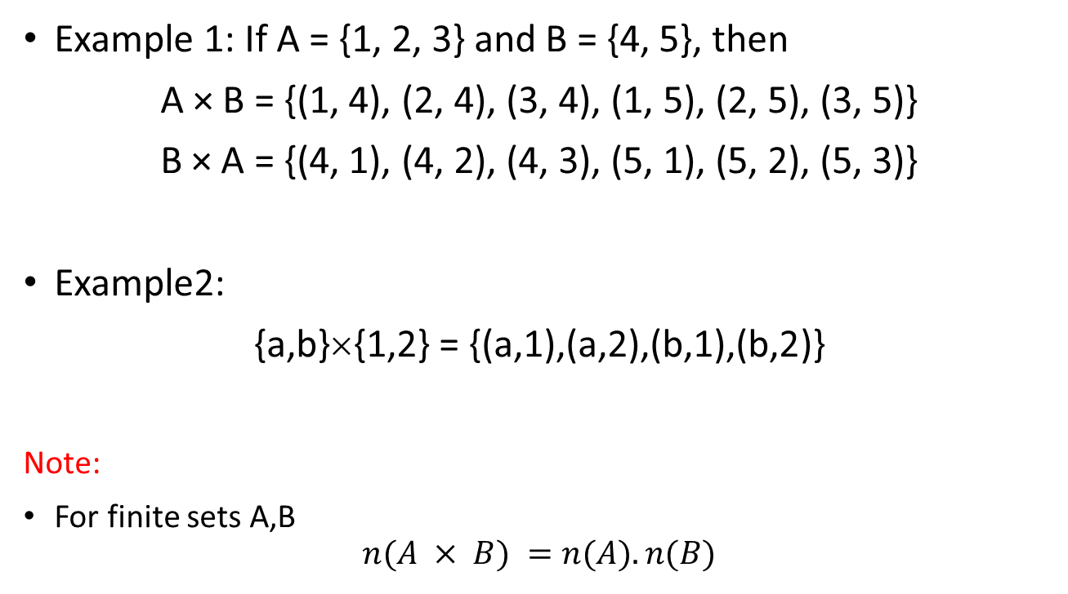
Cartesian Products of Sets
Example 1: If A = {1, 2, 3} and B = {4, 5}, then
A × B = {(1, 4), (2, 4), (3, 4), (1, 5), (2, 5), (3, 5)}
B × A = {(4, 1), (4, 2), (4, 3), (5, 1), (5, 2), (5, 3)}
Example2:
{a,b}×{1,2} = {(a,1),(a,2),(b,1),(b,2)}
Note:
For finite sets A,B
$$n(A × B) =n(A).n(B)$$

Slide 5
Find the following Cartesian Products of sets
Q1) Let A={1,2} and B={a,b,c}
Find A x B
B x A?
A x A?
Q2) If A={a,b} and B={1,2,3}, Find A x B

Slide 6
Find the following Cartesian Products of sets
Q3) If A={a,b}, B={1,2}, C={2,3} Find
A x (B ∪ C)
(A x B) ∪ (A x C)
A x (B ∩ C)
(A x B) ∩ (A x C)

Slide 7
Relations
A “relation" is just a relationship between sets of information.
Think of all the students in your class and think of their heights. The pairing of names and heights is a relation.
In relations, the pairs of names and heights are "ordered", which means one comes first and the other comes second.

Slide 8
Relations - Definition
A Relation $R$ from a non-empty set $A$ to a non-empty set $B$ is a subset of the Cartesian product set $A × B$.
The subset is derived by describing a relationship between the first element and the second element of the ordered pairs in A × B.
The set of all first elements in a relation R, is called the domain of the relation R, and the set of all second elements called images, is called the range of R.

Slide 9
Definition (Cont.)
Let A and B be sets. A binary relation or simply a relation from A to B is a subset of A x B.
Suppose R is a relation from A to B. Then R is the set of ordered pairs where each first element comes from A and each second element comes from B.

Slide 10
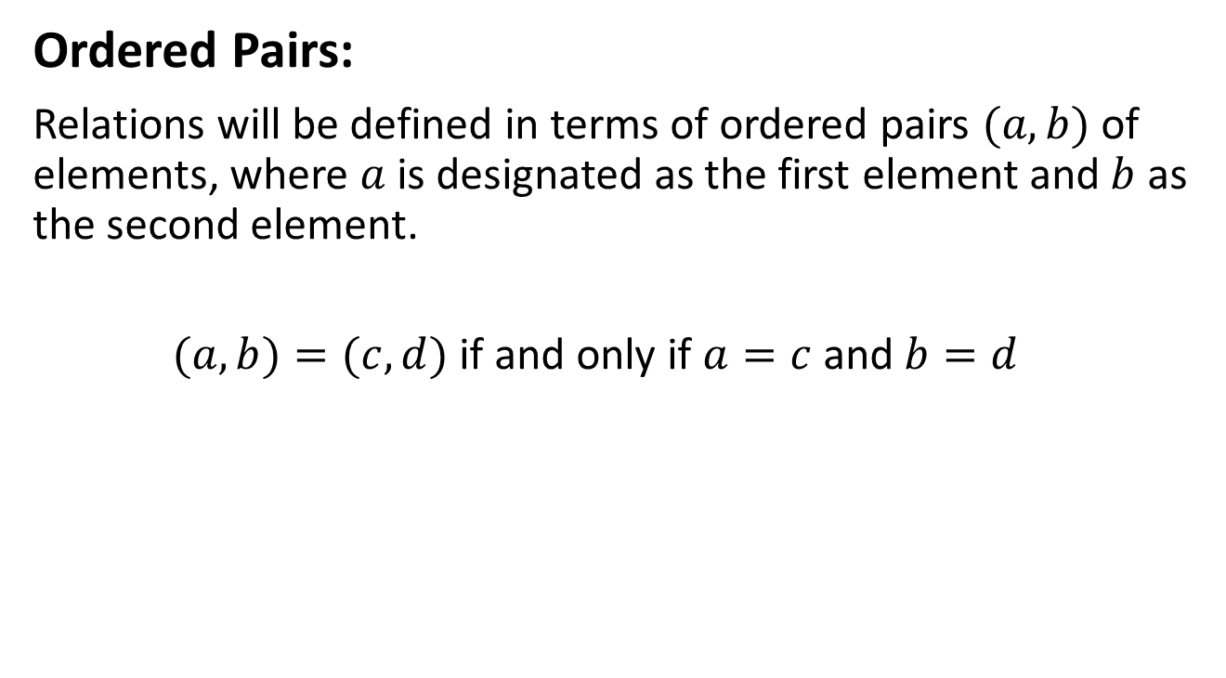
Relations
Ordered Pairs:
Relations will be defined in terms of ordered pairs $(a,b)$ of elements, where $a$ is designated as the first element and $b$ as the second element.
$(a,b)=(c,d)$if and only if $a=c$and $b=d$

Slide 11
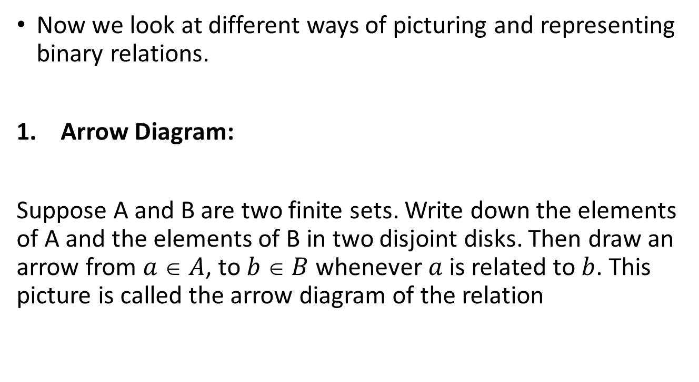
Pictorial representations of relations
Now we look at different ways of picturing and representing binary relations.
Arrow Diagram:
Suppose A and B are two finite sets. Write down the elements of A and the elements of B in two disjoint disks. Then draw an arrow from $a  A$, to $b  B$whenever $a$ is related to $b$. This picture is called the arrow diagram of the relation

Slide 12
Pictorial representations of relations
1
2
2
4
3
6
4
8
5
10
Domain (set of all x’s)
Range (set of all y’s)
This relation can be written {(1,6), (2,2), (3,4), (4,8), (5,10)}

Slide 13
Q) Write the following relations in ordered pairs
1.
1
2
2
4
3
6
4
8
5
10
Set A
Set B

Slide 14
2.
1
2
2
4
3
6
4
8
5
10
Set A
Set B

Slide 15
Pictorial representations of relations
Directed Graphs
These graphs are used to picture a relation R, which is a relation from a finite set to itself.
Example: Draw the directed graph of the relation R on the set
A ={1, 2, 3, 4},
R={(1,2), (2,2), (2,4), (3,2), (3,4), (4,1), (4,3)}

Slide 16
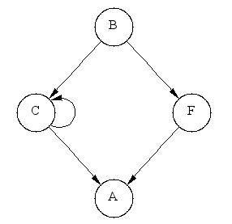
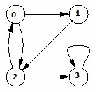
Find the relations of the following directed graphs
1. 2.

Slide 17
Functions
A function f is a relation in which each element of the domain is paired with exactly one element of the range.
1
2
2
4
3
6
4
8
5
10
Set A is the domain
Set B is the range

Slide 18
Functions
Is the following relation a function?
1
2
2
4
3
6
4
8
5
10
Set A is the domain
Set B is the range
Must use all the x’s
The x value can only be assigned to one y
Notes:
Yes

Slide 19
Functions
Is the following relation a function?
1
2
2
4
3
6
4
8
5
10
Set A is the domain
Set B is the range
Notes:
Yes.

Slide 20
Functions
Is the following relation a function?
1
2
2
4
3
6
4
8
5
10
Set A is the domain
Set B is the range
Notes:
No, 2 is paired with 4 and 10. Each x value should be paired with 1 value in the range.

Slide 21
Thank You!

